Slide 1
Design and Layout of two level shifting printed circuit boards
Richard McManus
University of Notre Dame, Electrical Engineering

Slide 2
Background
AWG
AWG Trigger 1 Bit
Reversable Clock
24 total inputs
(SMA connects)
FPGA program bit-stream download (JTAG)
-IO 16 Bit (In/Out)
-Mem/Write (Out)
-PC Out 16 Bit
-Reset 1 Bit In
0 - 1.8v <-> +/-0.7V
PC
FPGA
Level Shifting
MIPS
FPGA upload program results after program is completed (JTAG)
DIN 5 Pin
Power Supply
Power Supply

Slide 3
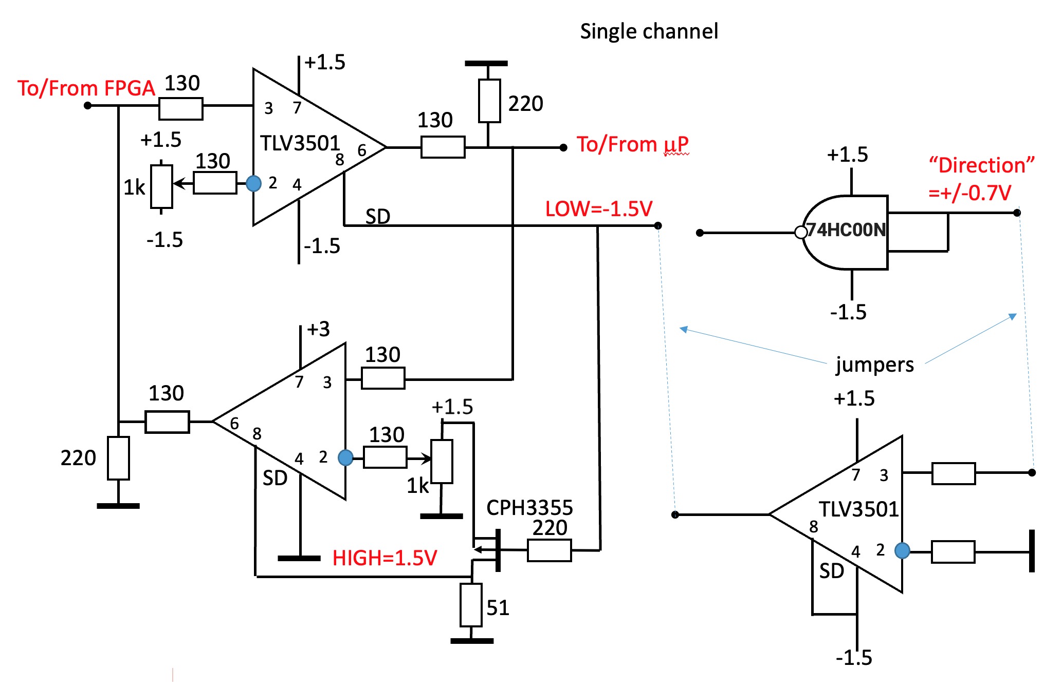
Single Channel Circuit (Dr. Orlov)

Slide 4
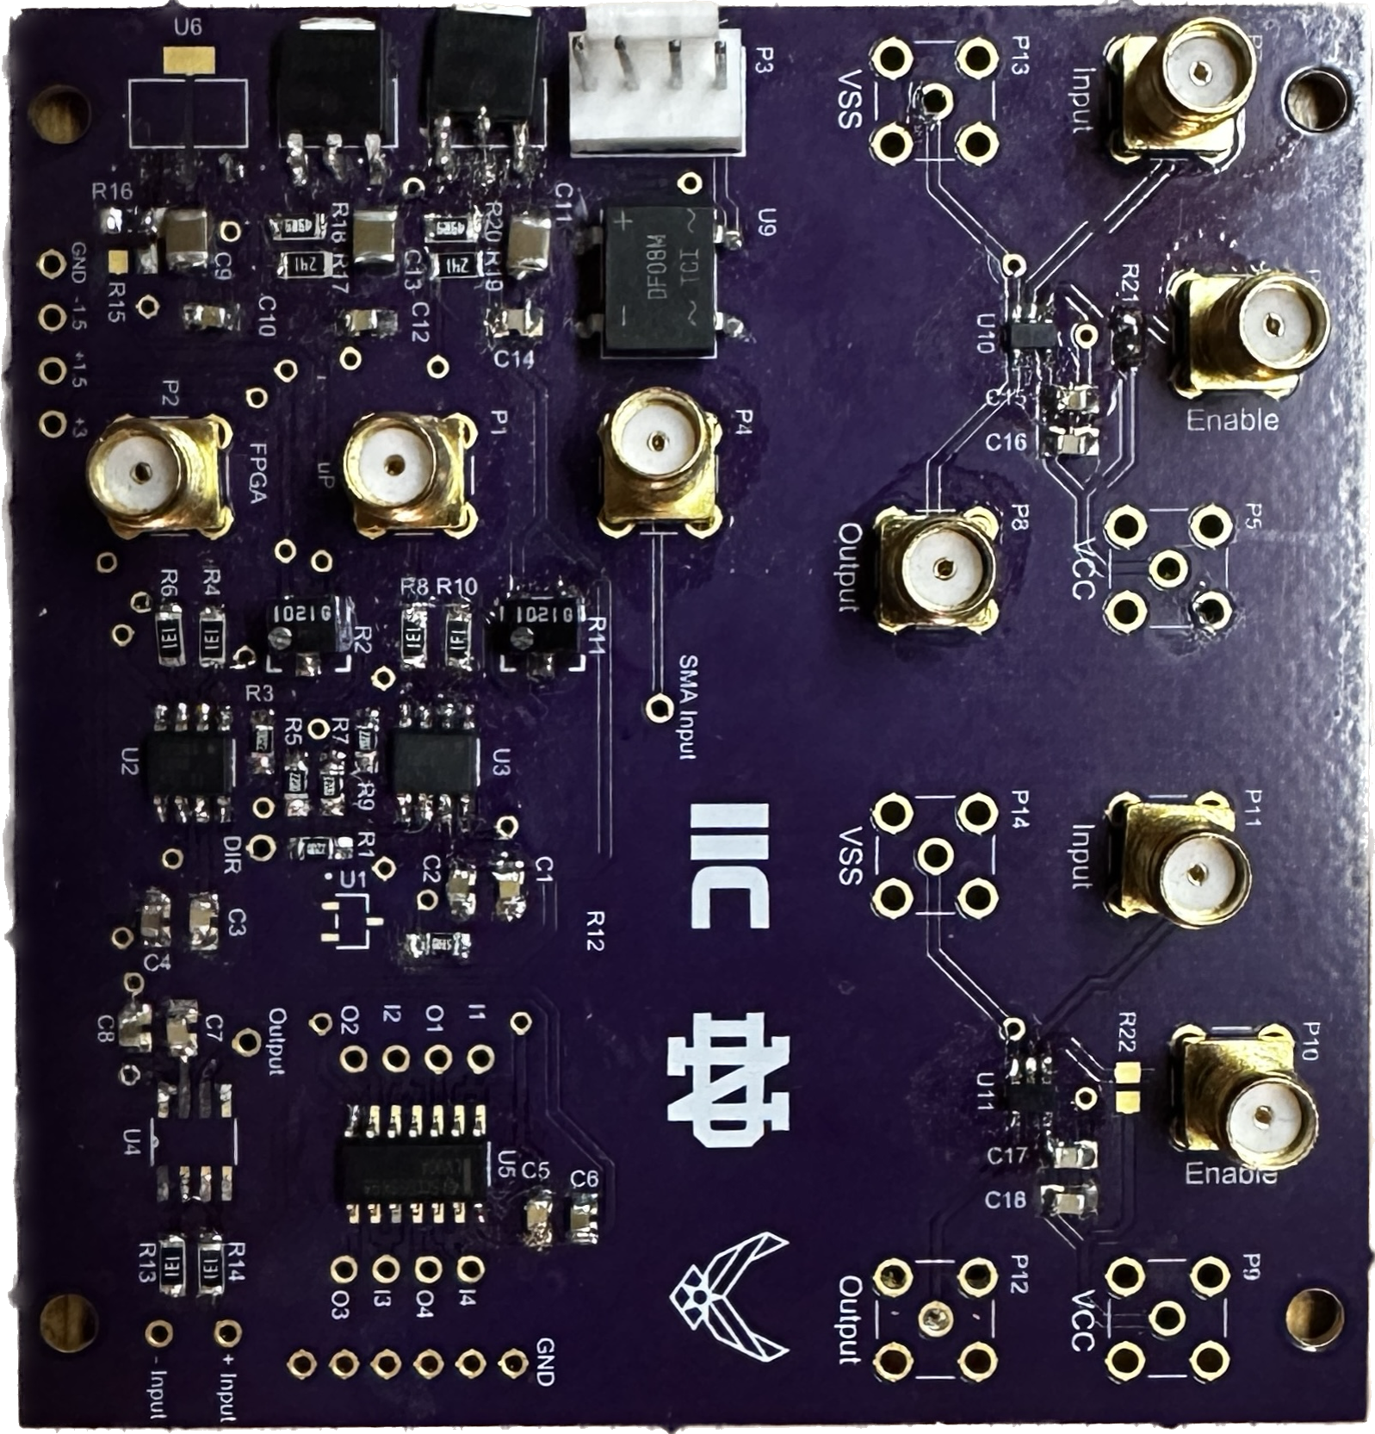
Previously Designed Board
Single Channel
Proved Viability

Slide 5
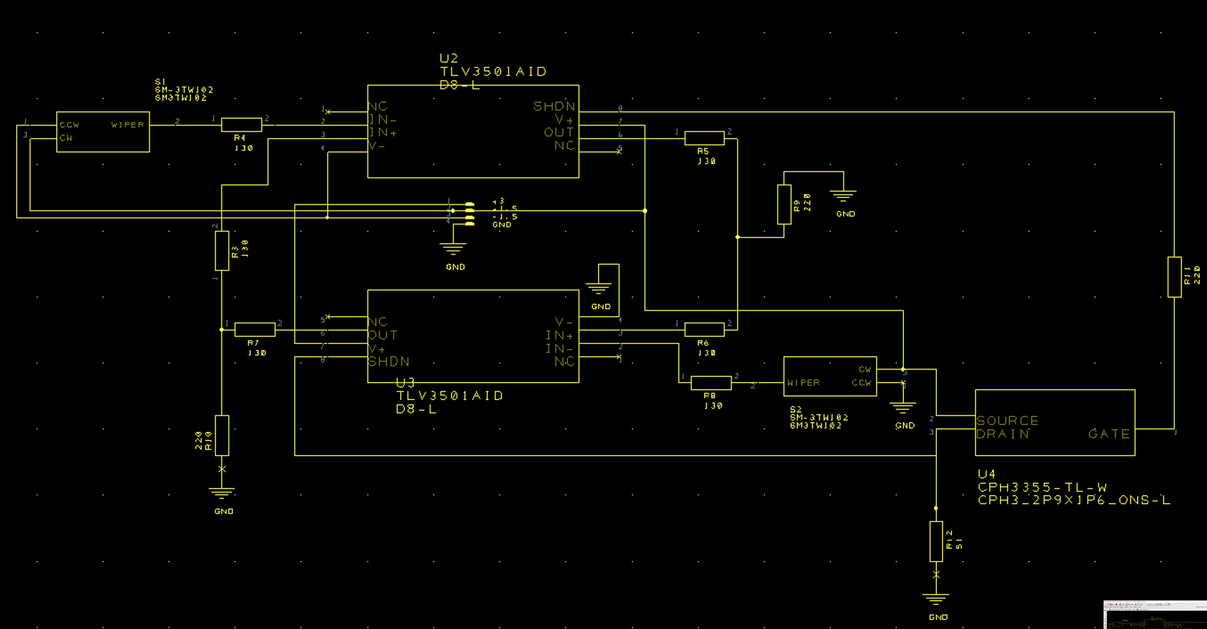
Single Channel Schematic
Design Spark
Compiled part libraries from distributors (Digikey, Mouser, etc.)
Created schematic

Slide 6

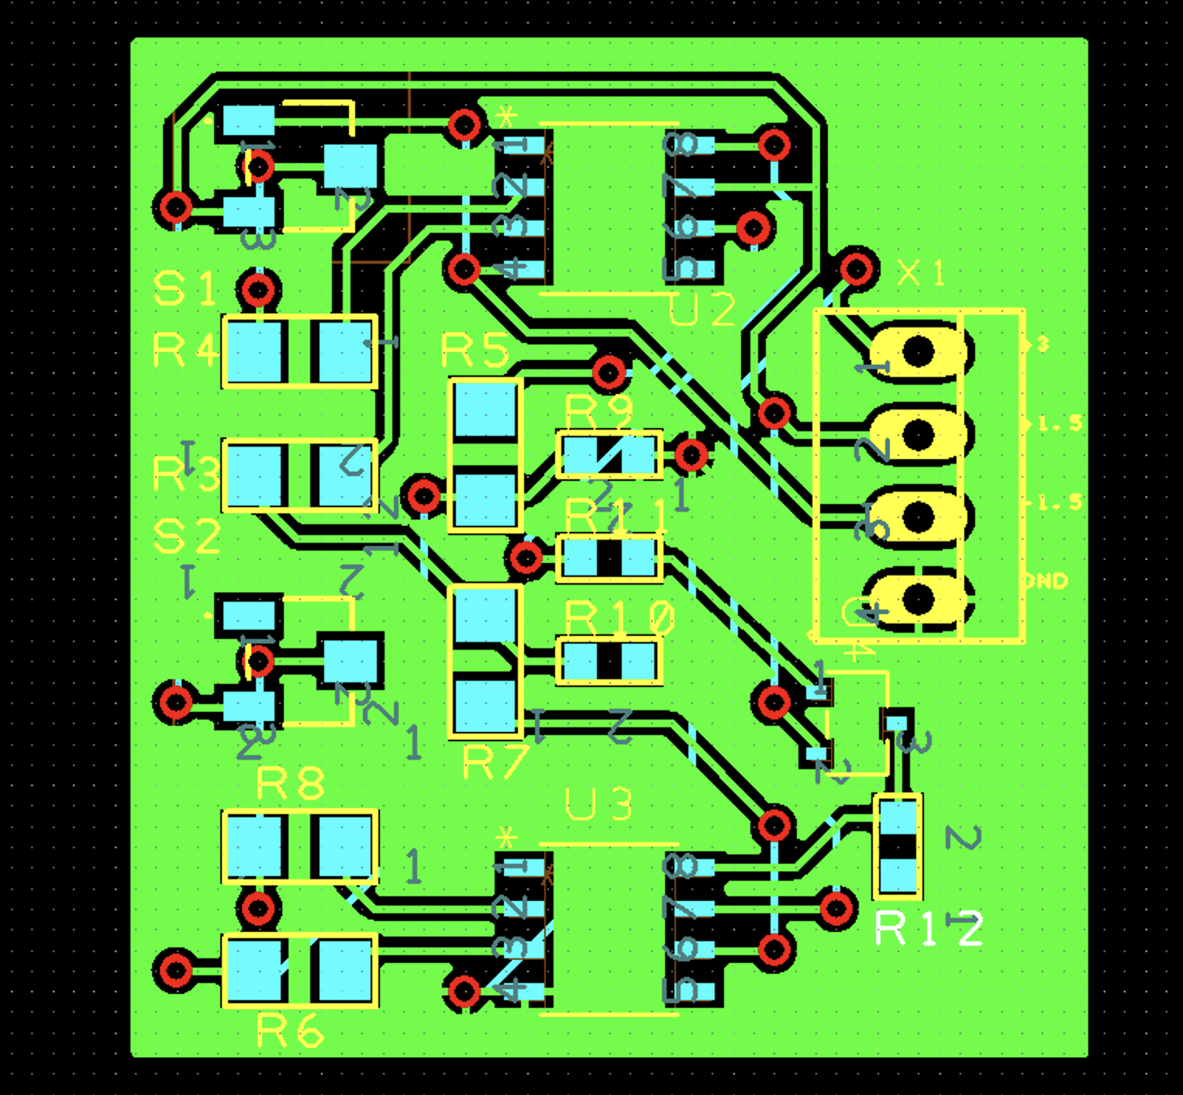
Single Channel Layout

Slide 7
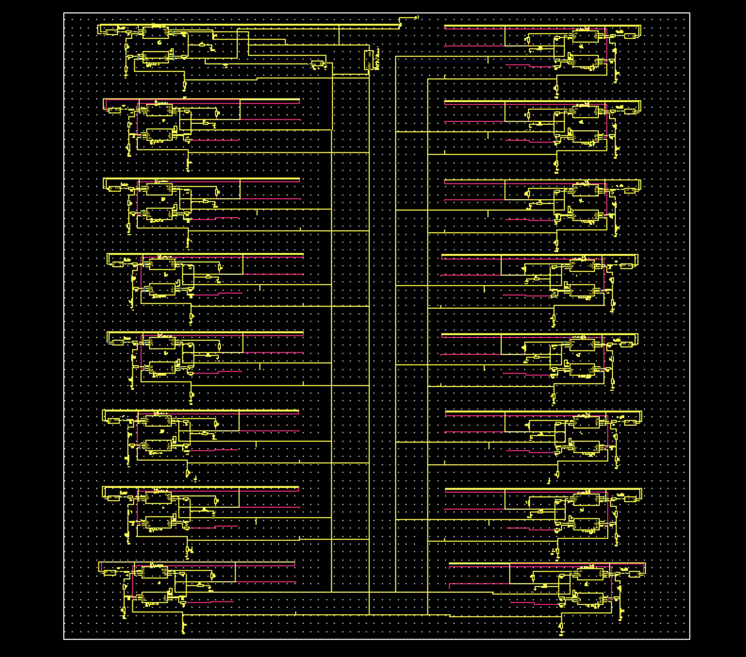
Multi-Channel Schematic (Design Spark)
Discovered License for Design Spark Pro is required for hierarchical design
Attempted to copy/paste all schematics
Schematic quickly became cluttered and difficult to manage

Slide 8
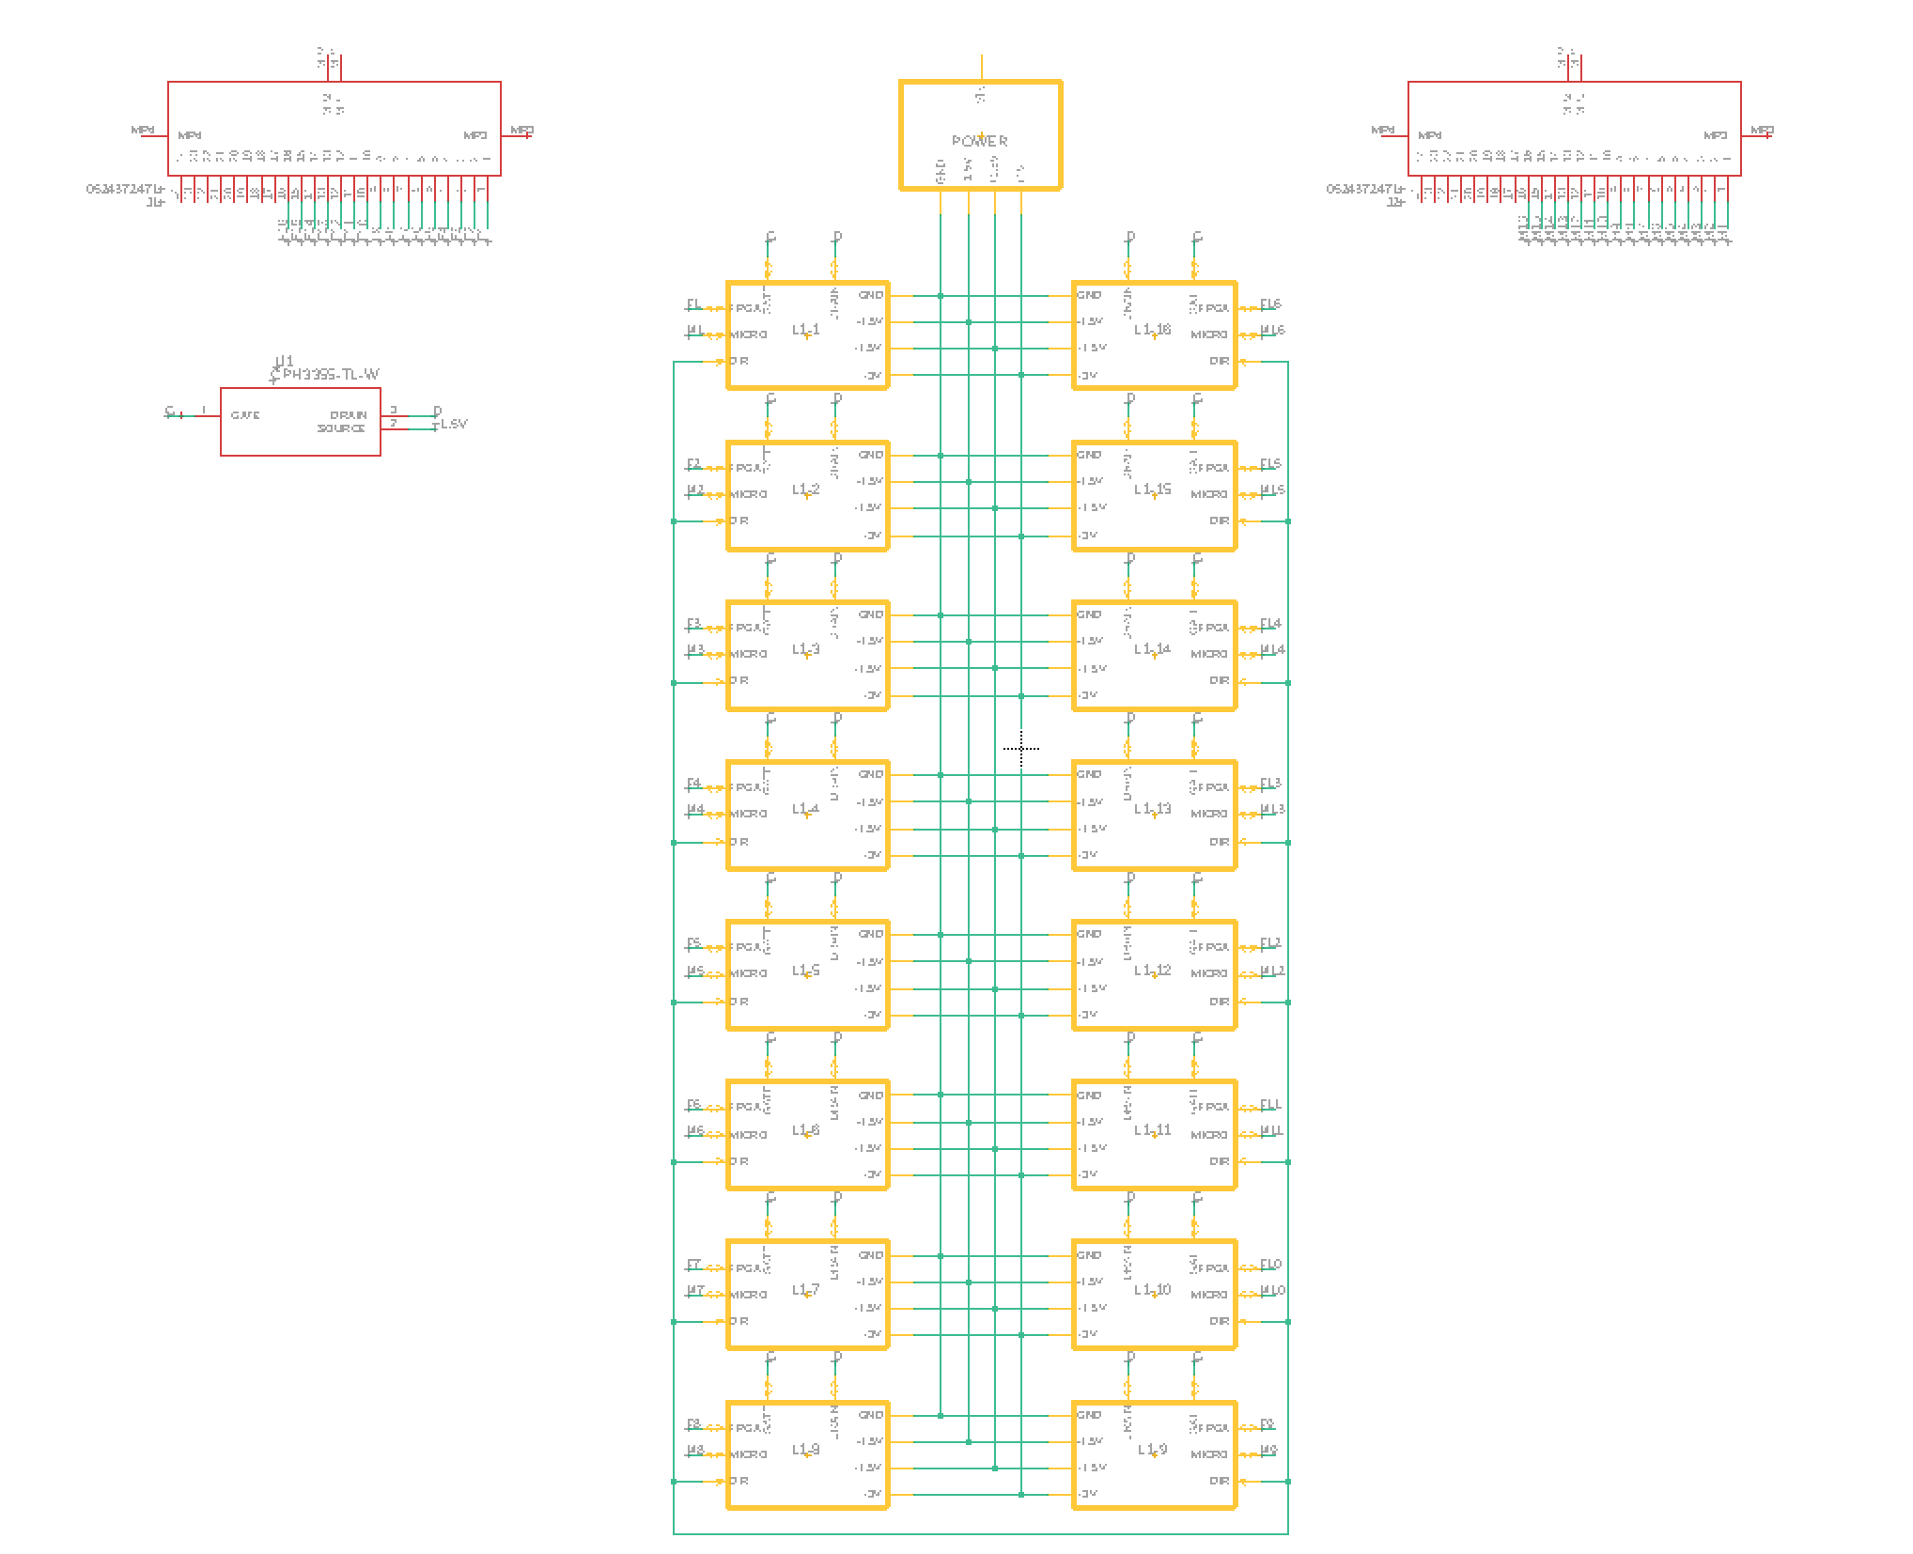
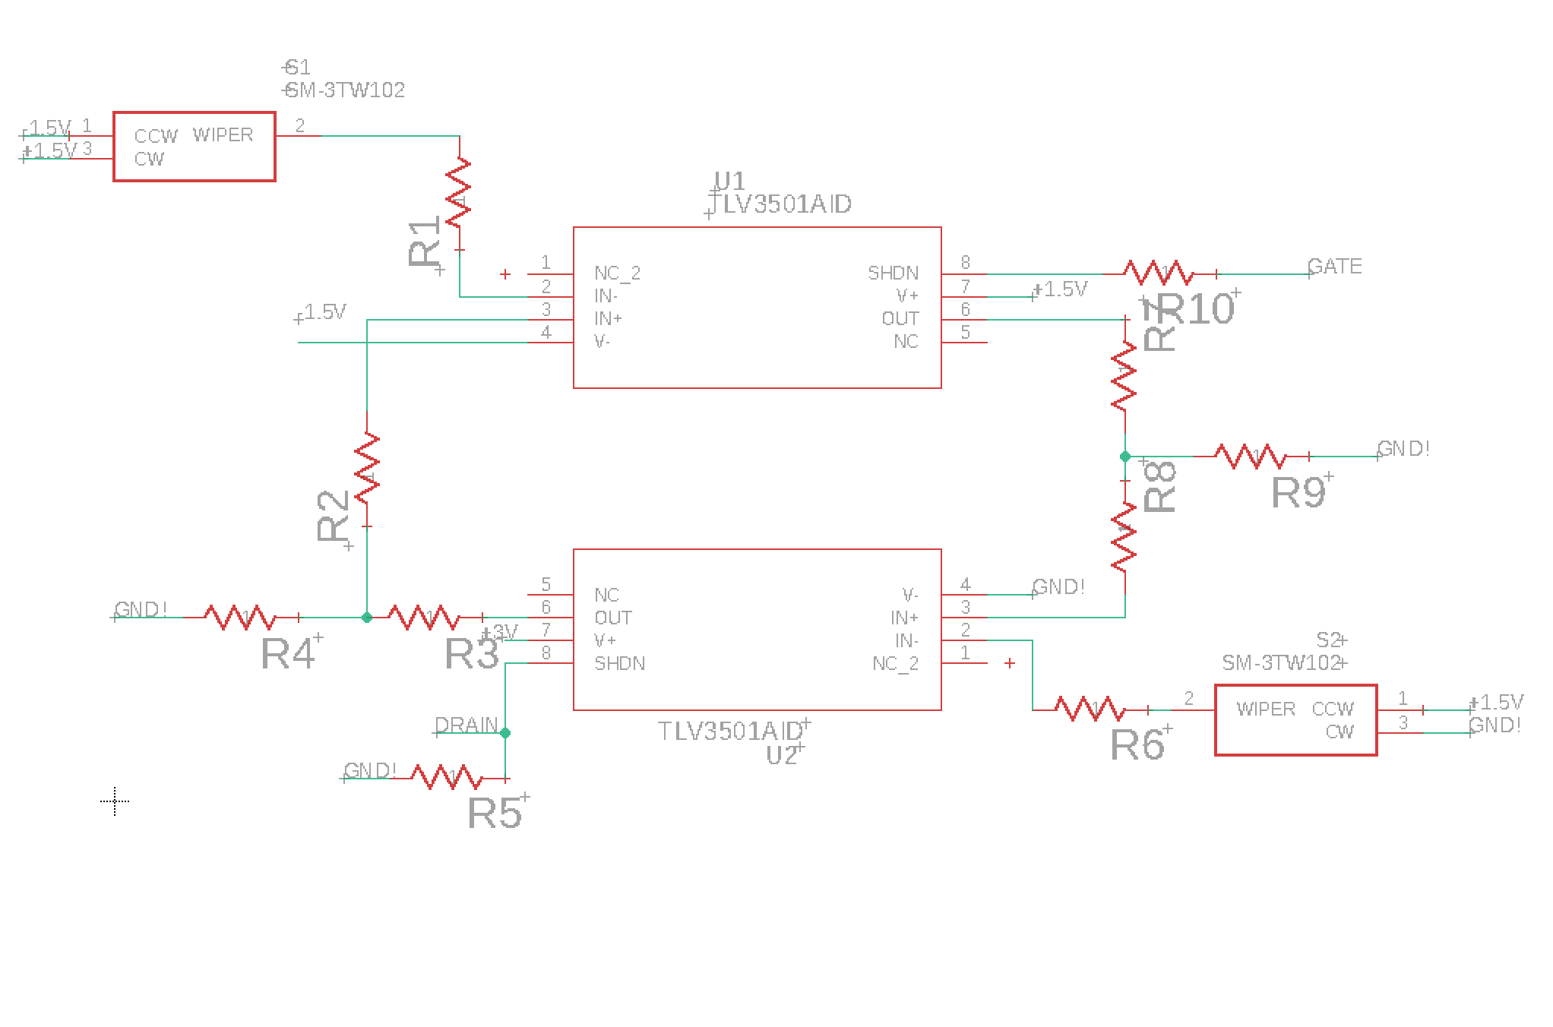
Multi-Channel Schematic (EAGLE)
Hierarchical design allows for modules
16 level shifting modules
1Power Module
2 ribbon cable connectors
1 direction controlling MOSFET

Slide 9
Second Board – FMC to Card Edge
.
.
.
.
Probe Card
FMC Cable
FMC Connector (400 pin)
Voltage Dividers
Card Edge Connector
.
.
.
.

Slide 10
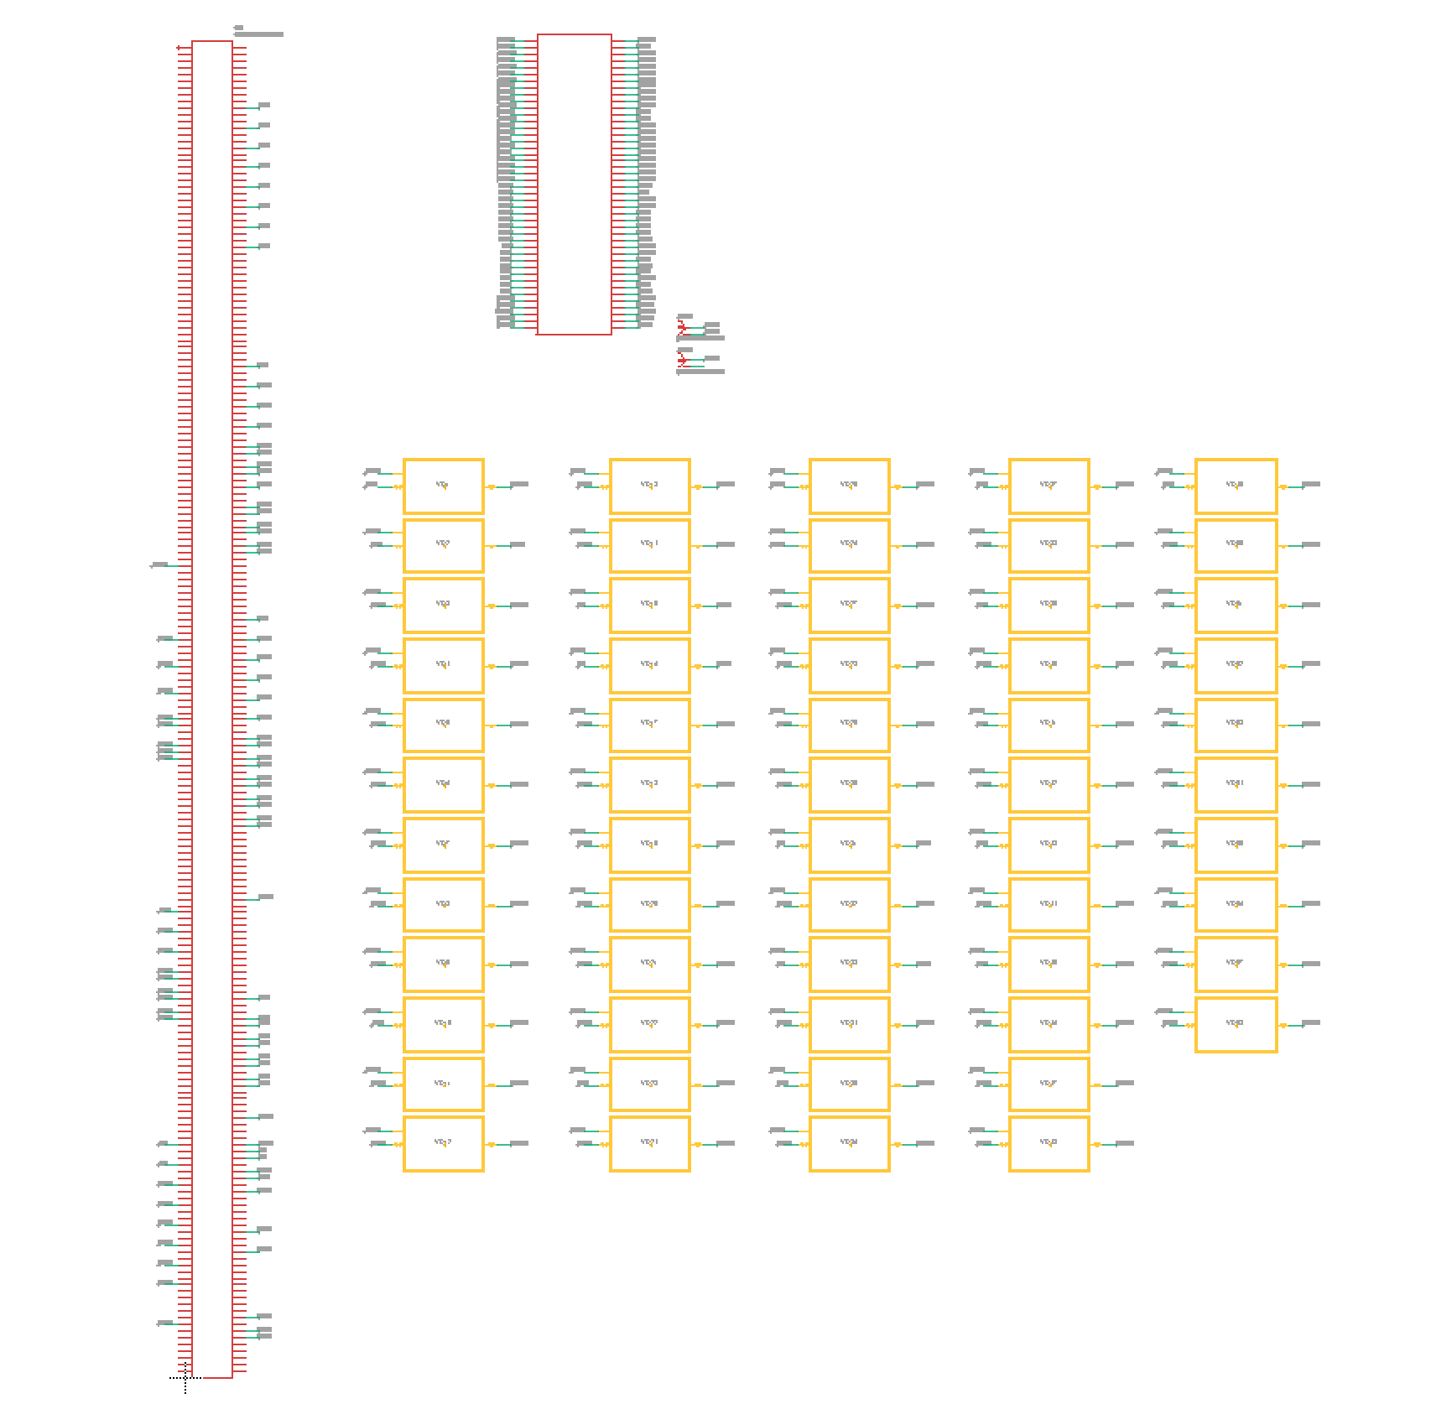
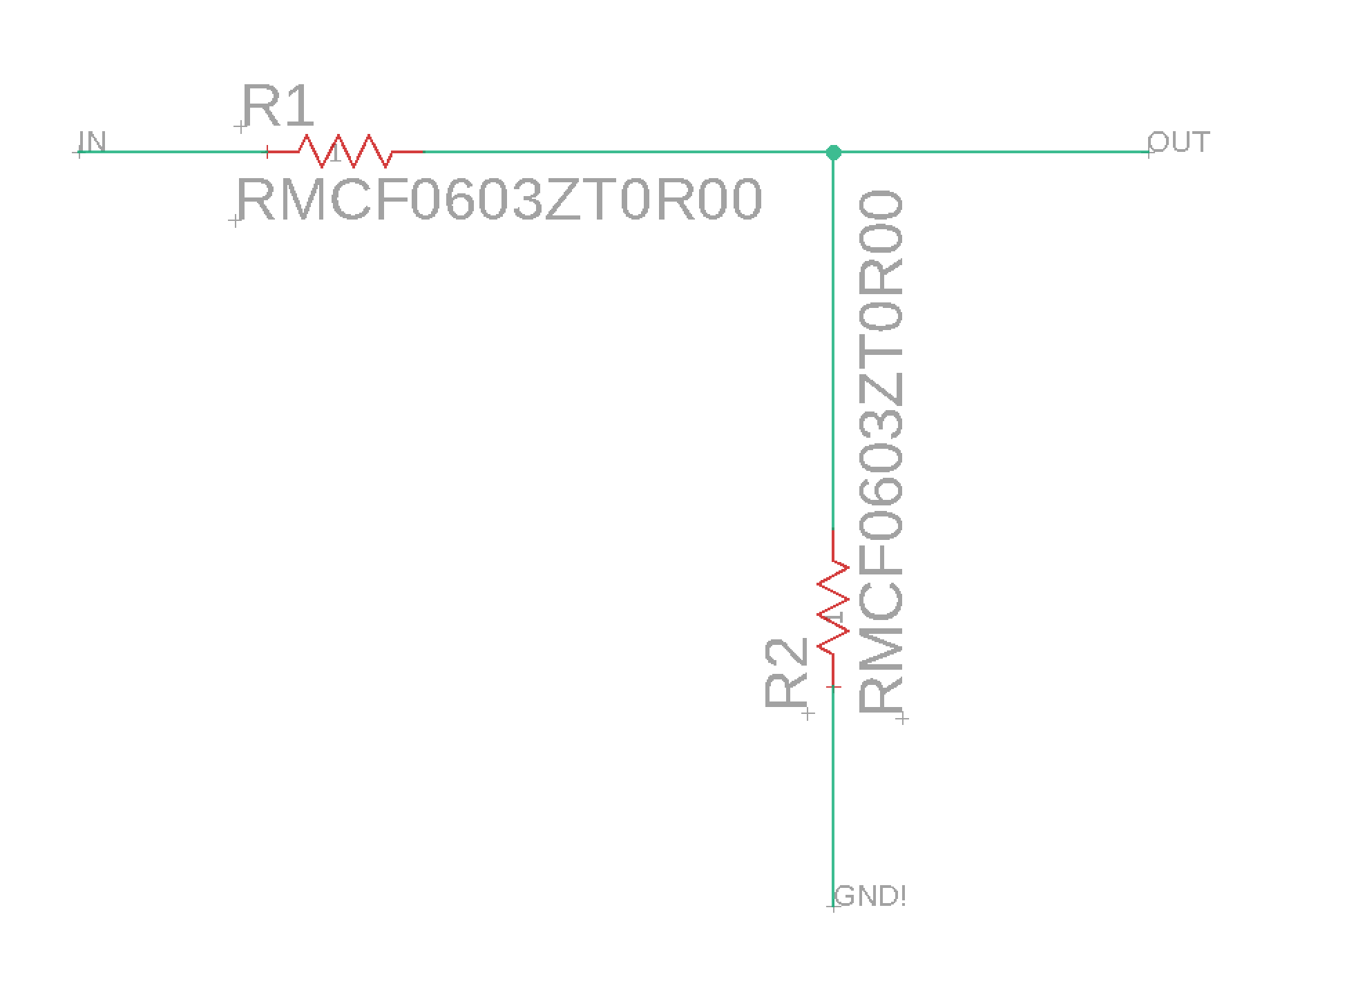
FMC To card Edge Schematic
Created card edge connector footprint and symbol
58 voltage divider modules for level shifting in and in/out signals
26 out signals do not require level shifting

Slide 11
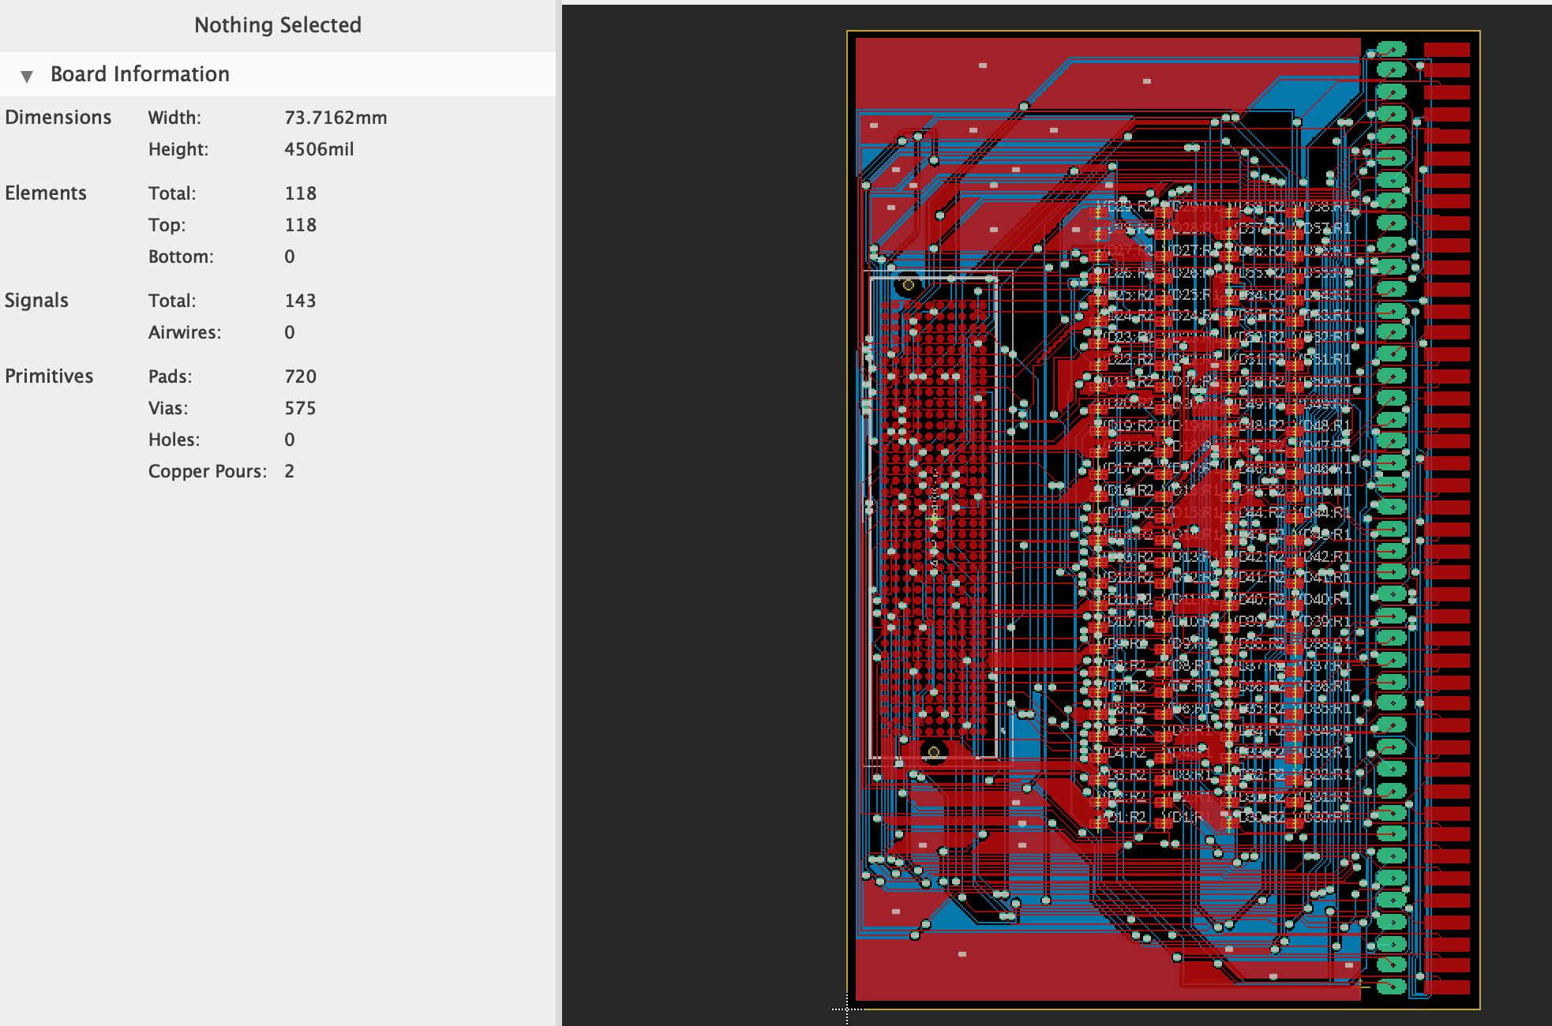
FMC to Card Edge layout

Slide 12
Design Modification
Probe Card
Reoriented FMC Connector
Added GND and VDD SMAs
.
.
.
.
Card Edge Connector
Voltage Dividers
.
.
.
.
GND
VDD
FMC Connector (400 pin)
FMC Cable

Slide 13
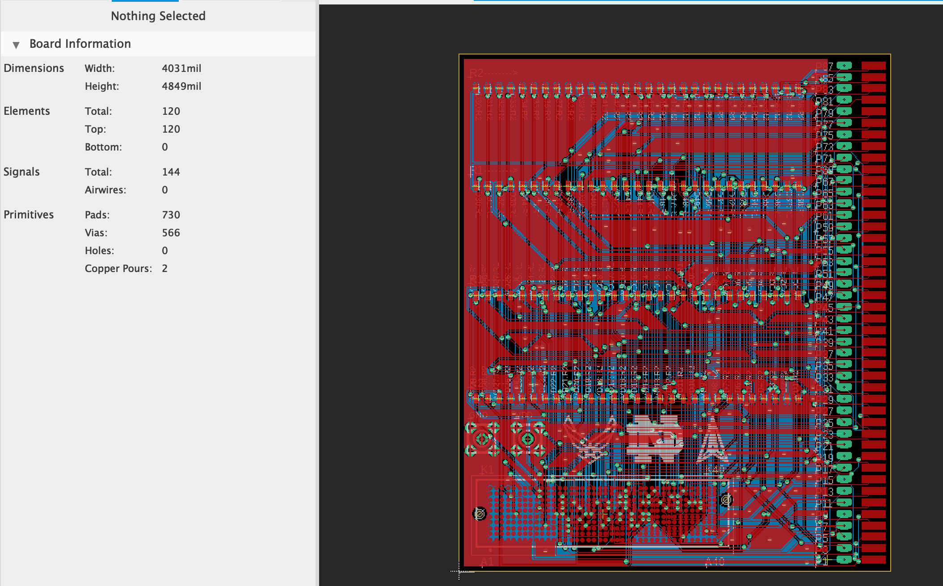
Revised FMC to Card Edge Layout

Slide 14
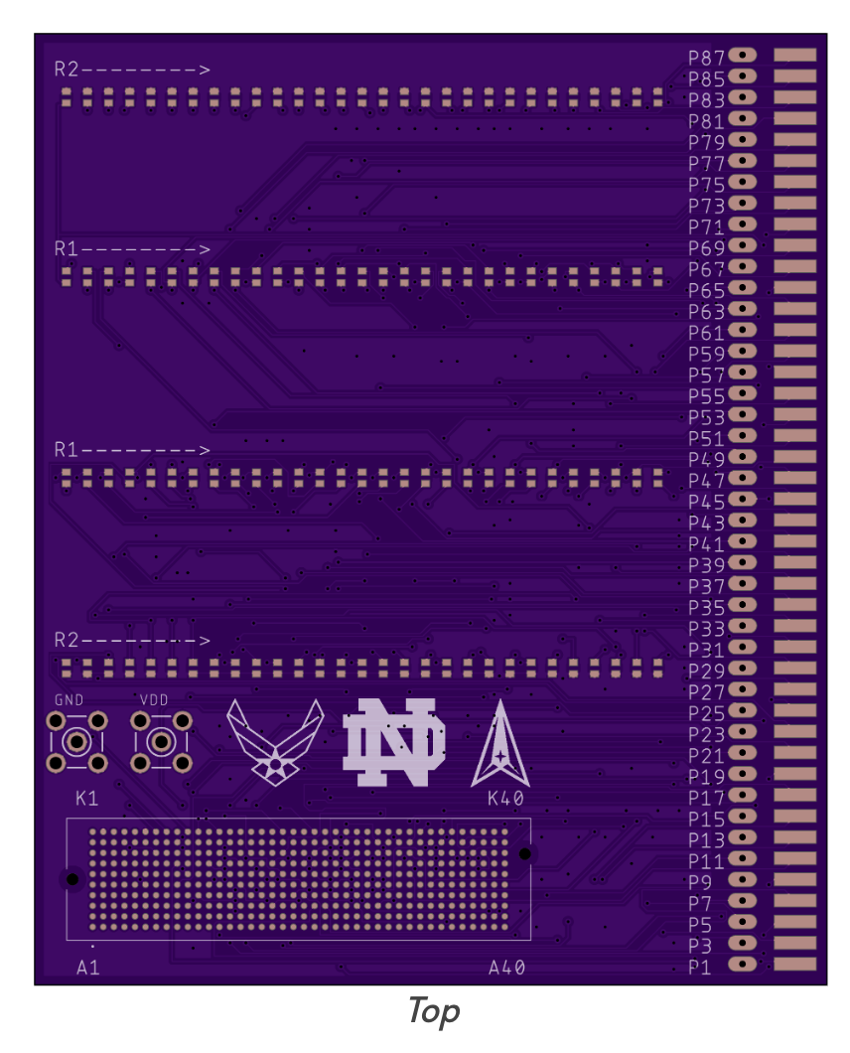
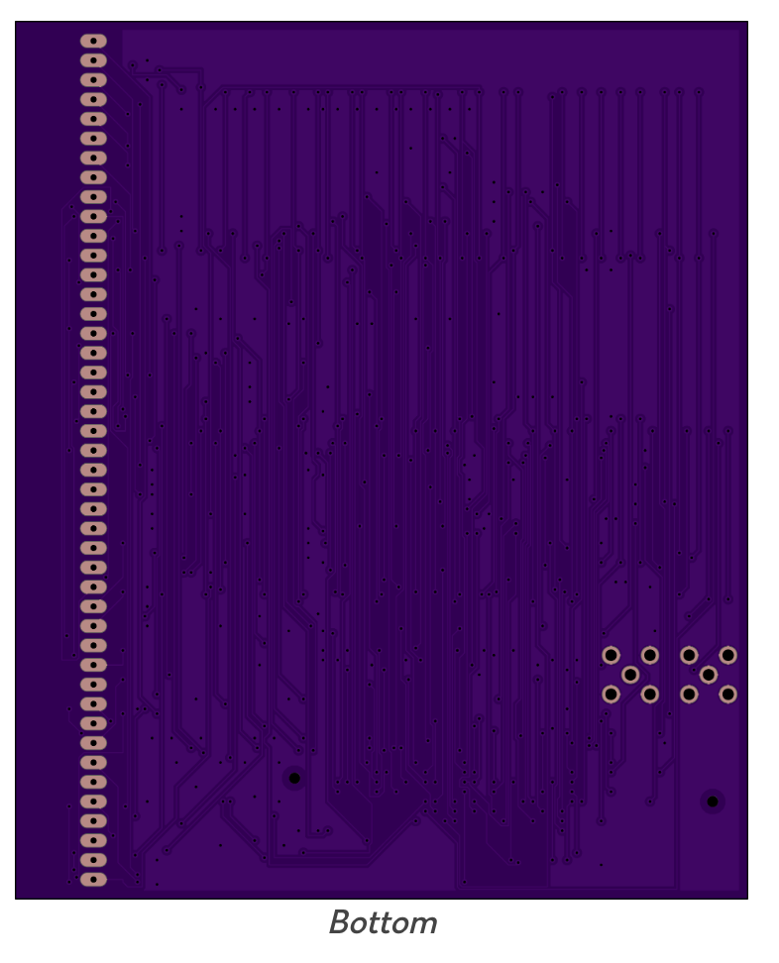
Fabrication - Board
oshpark.com: ordered 3 boards

Slide 15
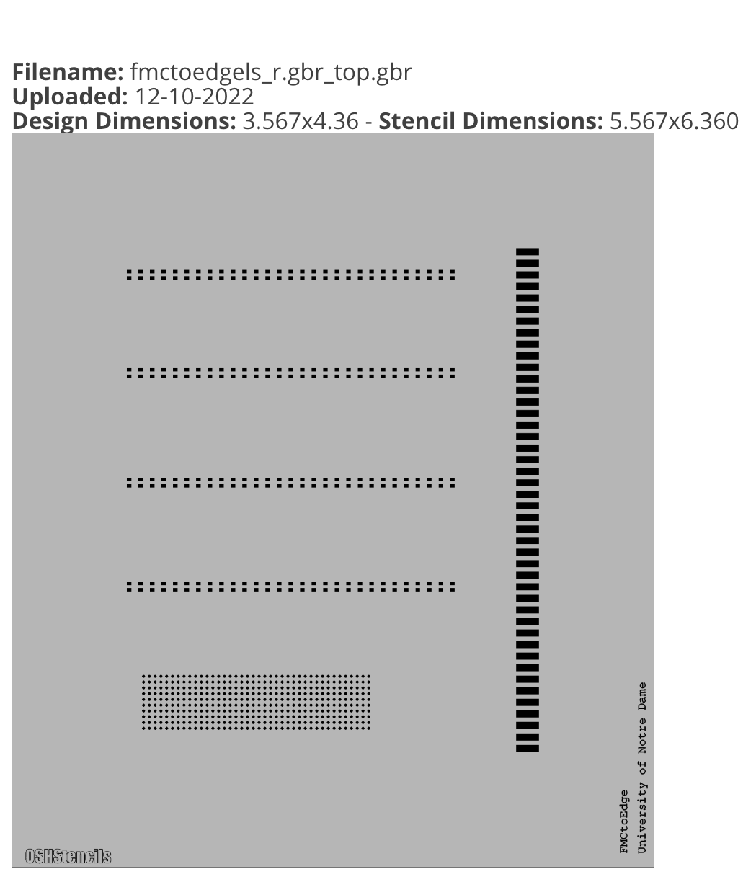
Fabrication – Stencil
oshstencils.com

Slide 16
Next Steps
Receive Board and Stencil
Board expected to be fabricated by December 16th
Stencil has been shipped and expected to arrive December 16th
Assembly
Solder resistors and FMC Connector using reflow oven
Solder SMA connectors and edge connector by hand
Ready for testing!

Slide 17
Thank You!

